Slide 1
NETWORKING

Slide 2
Computer network refers to interconnected computing devices that can exchange data and share resources with each other.
The field of networking and communication includes the analysis, design, implementation of an infrastructure that connects not only people but devices together.
Networked devices use a system of rules, called communications protocols, to transmit information over physical or wireless technologies.
The standardization of protocols is an international effort.
Since it would otherwise be impossible for different kinds of machines and operating systems to communicate with one another of there is no standardized way to do so.

Slide 3
OSI MODEL
open systems interconnection(OSI) s a conceptual framework used to describe the functions of a networking system.
The OSI model characterizes computing functions into a universal set of rules and requirements in order to support interoperability between different products and software.
In the OSI reference model, the communications between a computing system are split into seven different abstraction layers: Physical, Data Link, Network, Transport, Session, Presentation, and Application.
The OSI model was published in 1984 by the International Organization for Standardization (ISO) and is still used today as a means to describe Network Architecture.

Slide 4
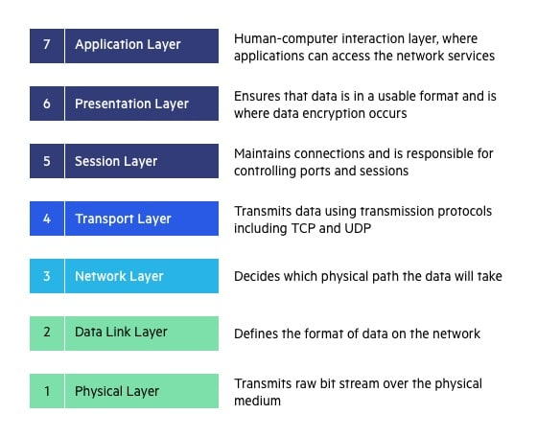

Slide 5
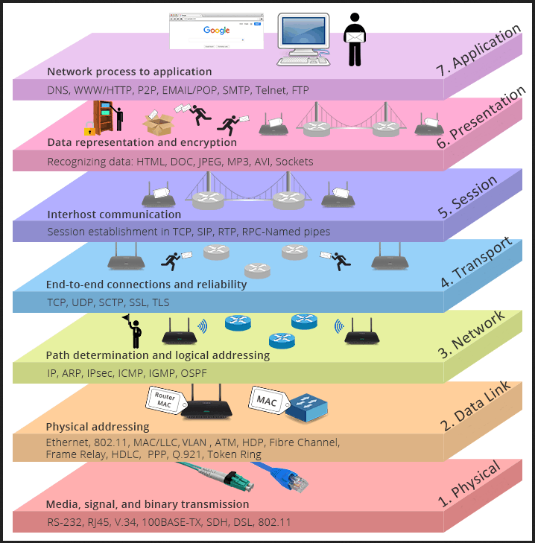

Slide 6
Physical Layer
The physical layer is the lowest layer of the OSI model. It’s responsible for the physical connectivity of devices in the network.
It also takes care of mechanical, electrical, procedural, and functional specifications for communication.
Functions:
  Transmission mode: It defines a transmission mode from Simplex, half-duplex, and full-duplex.
  Network Topology: It specifies the arrangement of devices in a network.
  Physical characteristics of the transmission medium
  Line Configuration: It selects from either point-to-point or multi point line configuration.
  Data Rate: The physical layer defines the number of bits transmitted per unit of time.
At the physical layer, one might find “physical” resources such as network hubs, cabling, repeaters, network adapters or modems.

Slide 7
Data Link Layer(DLL)
The data link layer is responsible for making sure that the data transfer is error-free from one node to another over the physical layer.
The data link layer is implemented by data link devices such as switches, bridges, and network interface cards (NIC) of devices.
To function, the data link layer utilizes data link protocols such as ethernet, wifi, ARP, PPP, NDP, etc.
When a data packet arrives over the network then the Data Link Layer is responsible for transmitting those packets to the Host using its MAC address.
The DLL is divided into two sublayers:
  LLC(Logical Link Control): It deals with functions like flow control and error control.
  MAC(Media Access Control): It controls the physical addressing and framing functions of the data link layer

Slide 8
Functions of the Data Link Layer(DLL)
Flow Control: It makes sure that the transmitting speed and the amount of data sent to match the capacity and speed of the receiver so that no data gets corrupted.
Framing: DLL adds certain bits at the beginning(called header which contains the source and destination addresses) and at the end(called trailer which contains error correction and detection bits) to the message frame.
Error Control: DLL uses CRC(cyclic redundancy check) to check if any error occurred during transmission.
Physical Addressing: DLL adds the physical address(MAC address) of the destination and source in the header of each frame.
Access Control: Determines which device has control over the link if the same communication channel is shared by multiple devices.

Slide 9
Network Layer
The network layer is responsible for finding the best path for the delivery of data packets from the source host to the destination host
To function, the network layer utilizes network protocols such as IP, ICMP, IGMP,
IP or internet protocol is the most common network layer protocol and it performs several functions, such as logical addressing/framing, routing, and path determination.
Functions:
  Host-to-host connectivity.
  Fragmentation: The network layer divides the received data into smaller fragments called packets.
  Routing: The network layer is responsible for finding the best possible path for a data packet to reach its destination, this is known as routing. “routers” are used to transfer packets for transmission. It uses the IP address to find out the destination address where to send it
  Logical Addressing: The network layer adds the source and destination’s IP address(which is used to identify a device uniquely universally) in the header of the frame.

Slide 10
Transport Layer
The transport layer is the heart of the OSI model, because it is responsible for providing transport services between the application/session layer and network layer.
It ensures that data is delivered to the correct application services, that the end-to-end data communication is successful, and that delivery of data is error-free.
In order to function, transport layer utilizes transport layer protocols
  transmission control protocol (TCP)
  user datagram protocol (UDP).

Slide 11
Session Layer
This is the layer in charge of initiating and terminating communication between two devices. The session is the period between the start and end of the communication
The session layer is responsible for session authentication, session authorization, and session management (establishment, maintenance, and termination) to enable sending, tracking, and receiving data.
The session layer uses application programming interfaces (API), such as NetBIOS (network basic input-output system) which allows applications on different devices (computers or servers) to communicate with each other (i.e. to establish a session).

Slide 12
Presentation Layer
The presentation layer is concerned with the syntax and semantics of the information transmitted.
The presentation layer takes the data from the application layer and translates them into EBCDIC code (extended binary code decimal interchange code), and transfers it to the networks.
By default, the data of the application layer is in ASCII code (American standard code for information interchange). This conversion process is called translation.
Data compression(bit reduction). Data compression reduces the amount of space used to store the file, and also enhances speed.
Data Encryption is also done here through Secure sockets layer (SSL) protocol .

Slide 13
Application Layer
The application layer is the highest in the OSI Model. It is responsible for presenting and creating user data, and communicating this data to other applications or another device, and is implemented by network applications.
Network applications are software applications that use the internet. Examples of these are browsers like Firefox, email applications like Outlook, messengers like Skype, and others.
Network applications utilize application layer protocols in order to function.
  HTTP(Hypertext Transfer Protocol) or HTTPS(Hypertext Transfer Protocol Secure) protocols are used to provide web surfing services,
  FTP(File Transfer Protocol) protocol for providing file transfer services,
  SMTP(Simple Mail Transfer Protocol) protocol for email services,
  DNS(Domain Name System) for domain name directory services,
  Websocket for maintained bidirectional communication,
  TELNET for virtual terminal services. Telnet (short for "teletype network") is a client/server application protocol that provides access to virtual terminals of remote systems on local area networks or the Internet.

Slide 14
LAN and WAN
A local area network (LAN) is a computer network that interconnects computers within a limited area eg: an office building.Ethernet(physical layer) and Wi-Fi are the two most common technologies in use for local area networks.
A wide area network (WAN) is a telecommunications network that extends over a large geographic area. Network protocols including TCP/IP deliver transport and addressing functions. Protocols including Packet over SONET/SDH, Multiprotocol Label Switching (MPLS), Asynchronous Transfer Mode (ATM) and Frame Relay are often used by service providers to deliver the links that are used in WANs.
The Internet may be considered a WAN. Many WANs are, however, built for one particular organization and are private. WANs can be separated from local area networks

Slide 15
THE INTERNET
The Internet is the global system of interconnected computer networks that uses the Internet protocol suite (TCP/IP) to communicate between networks and devices.
The World Wide Web is what facilitates this connection and as users we access it through a web browser.
The web browser(chrome) communicates to a web server via the Hyper text transfer protocol(HTTP) which enable users to access and view web pages.
Web pages are documents written in HTML (Hypertext Markup Language) and contain text, images, multimedia, and other elements. and are accessible through unique addresses called URLs (Uniform Resource Locators).
Web servers are systems that host web pages and make them accessible to users.

Slide 16
Step 1: Client Requests Information
The process begins when a user, often referred to as a client, makes a request for information by entering a URL (Uniform Resource Locator) or clicking a link in a web browser.
Step 2: DNS Resolution
The client's request is sent to a DNS (Domain Name System) server to resolve the human-readable URL into an IP (Internet Protocol) address. DNS is like a phone book for the internet, translating domain names (e.g., www.google.com) into numerical IP addresses (e.g., 192.0.2.123).

Slide 17
Step 3: Establishing a Connection
Once the client has obtained the IP address, it establishes a connection with the appropriate server. This is typically done using the TCP/IP (Transmission Control Protocol/Internet Protocol)
Step 4: HTTP Request
After establishing a connection, the client sends an HTTP (Hypertext Transfer Protocol) request to the server. This request specifies the desired resource (e.g., a web page) and the desired action (e.g., GET, POST, PUT).

Slide 18
Step 5: Server Processing
The server receives the HTTP request and processes it accordingly. This may involve executing server-side scripts, retrieving data from a database, or performing any other necessary tasks to generate a response.
Step 6: HTTP Response
Once the server has processed the request, it generates an HTTP response containing the requested information. This response includes a status code (indicating the success or failure of the request) and the requested data (e.g., HTML content, images, or other files).
Step 7: Data Transmission
The server sends the HTTP response back to the client over the established connection. The data is divided into smaller packets for efficient transmission.

Slide 19
Step 8: Routing and Forwarding
As the response travels across the internet, it passes through multiple routers. These routers examine the destination IP address of each packet and determine the most efficient path to forward it to the next router. This process repeats until the packets reach the client.
Step 9: Reassembling the Response
Upon receiving the packets, the client's device reassembles them into the complete HTTP response.
Step 10: Rendering the Response
The client's web browser receives the response and interprets the HTML, CSS, and JavaScript code to render the web page. This includes displaying text, formatting, images, and interactive elements

